Slide 1

Submitted by: Team L (Alex Stark, Amir Hussain, Bhavan Pahuja, Israa Farouk, Jason Chen) Submitted To: Philmo Gu (Tutorial T02)
CPSC 481 – STAGE 4 PRESENTATION AR MUSEUM APP

Slide 2
Idea and Tasks Protoyped
AR Museum
AR Scanning
Timed tour
Virtual map
Ticket purchases

Slide 3

Prototype Demo

Slide 4
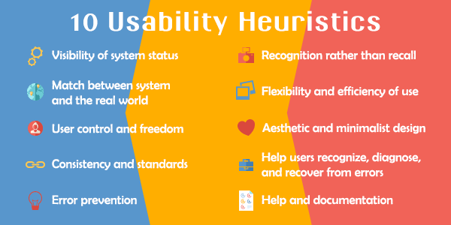
Heuristic Evaluation Process

Slide 5
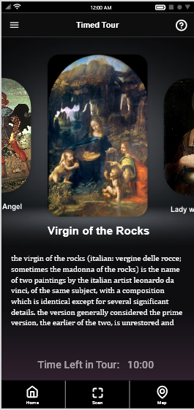
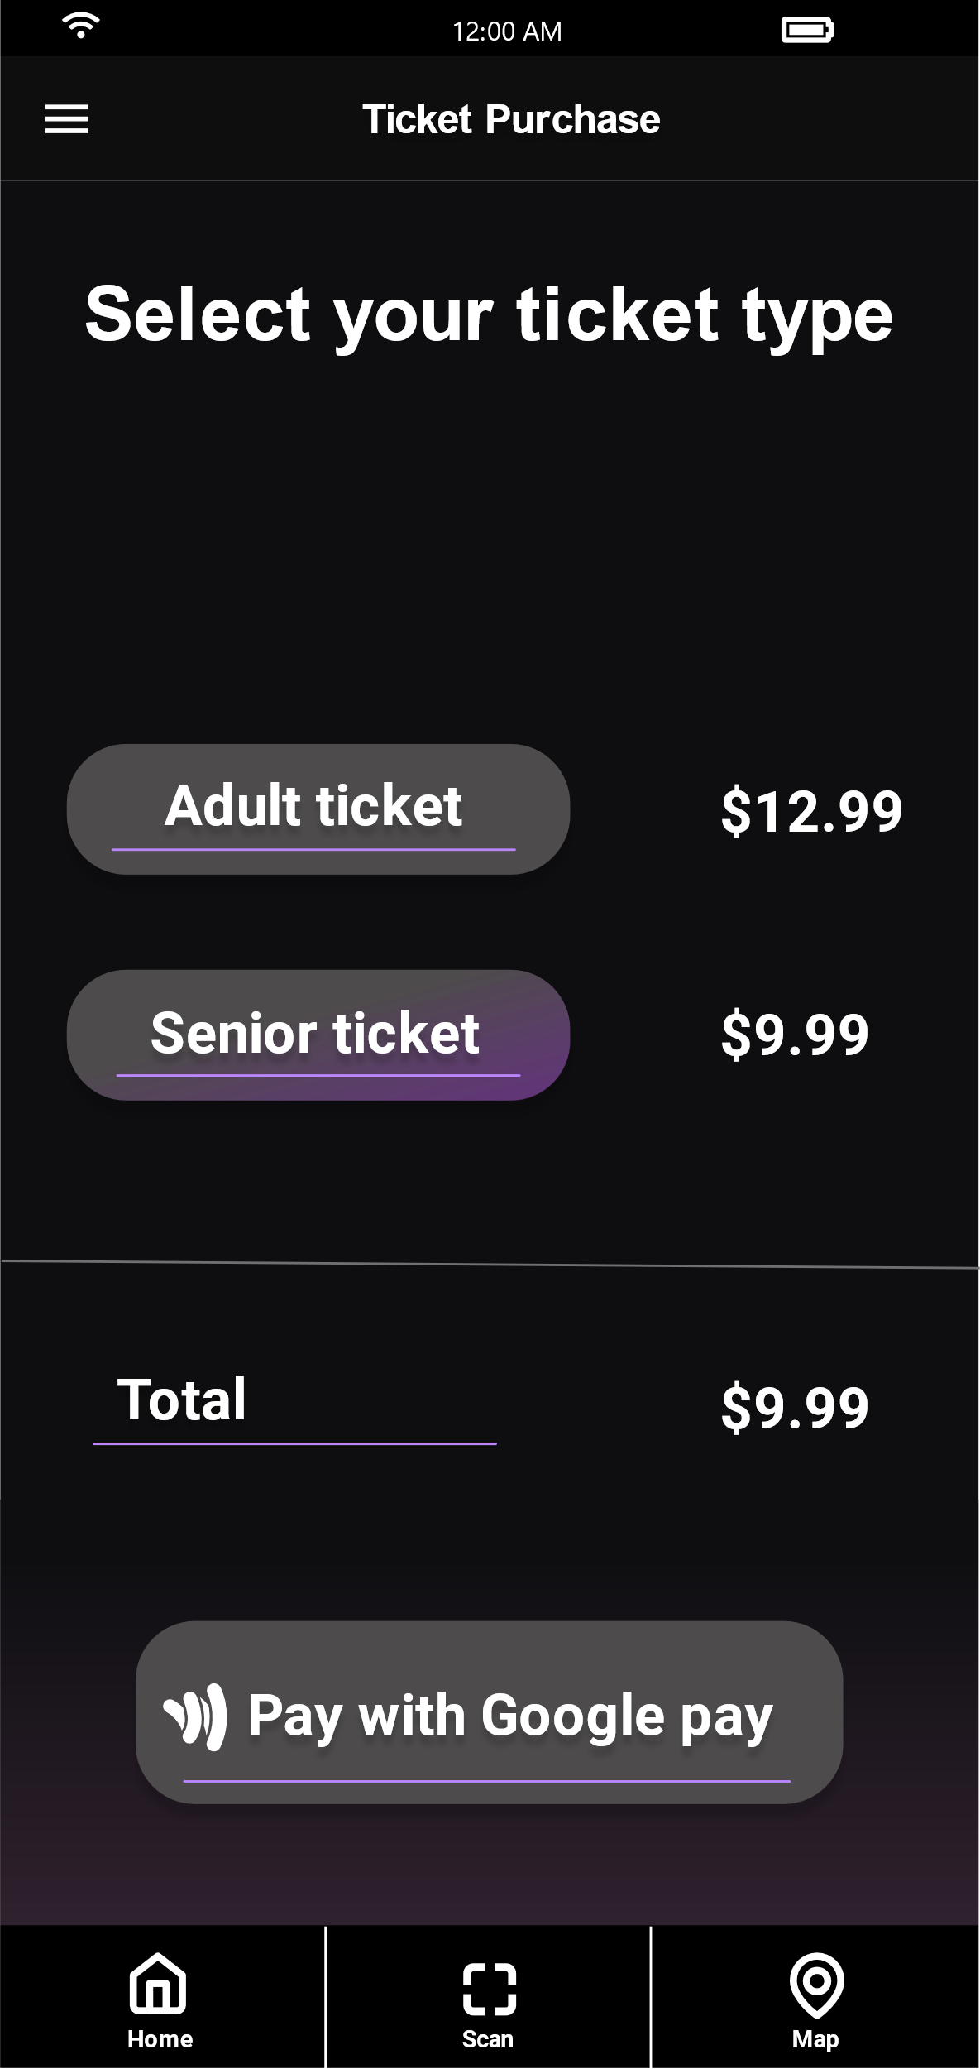
Heuristic Evaluation Findings
Visibility Of System Status:
No Confirmation for user on successful purchase of ticket.
Keeps user updated
on time left in tour.
Notes:
Conducting the heuristic evaluation brought all the problems with our prototype to light, we realized some of the oversights we had while designing our prototype. A major oversight we had was the lack of error messages to the user.
The severity ratings in the evaluation helped us categorize and prioritize the problems to solve. All the cosmetic problems and highly rated problems were solved.
We had a discussion about the various solutions we thought of for each problem to help us do this.
And n

Slide 6
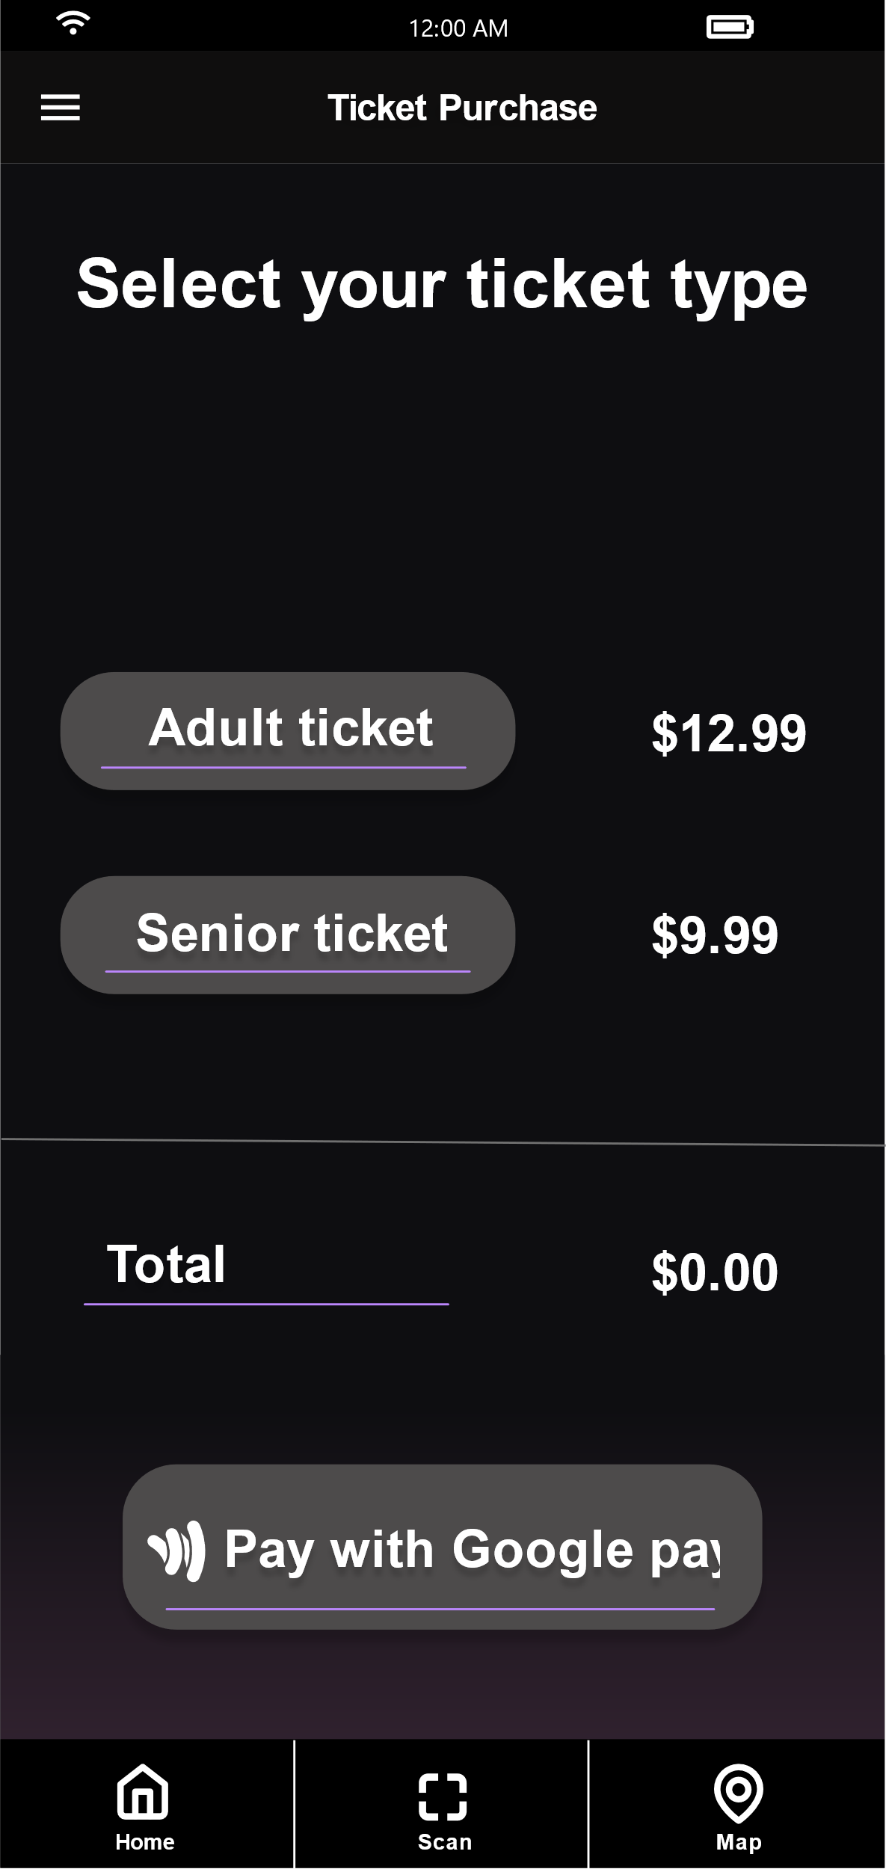
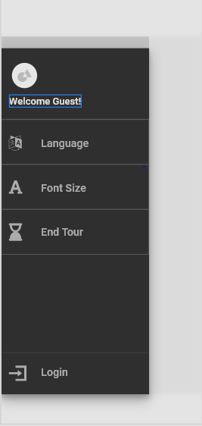
Heuristic Evaluation Findings
User control and freedom:
No Back
Button
End Tour Option
Hidden in Menu
Notes:
Conducting the heuristic evaluation brought all the problems with our prototype to light, we realized some of the oversights we had while designing our prototype. A major oversight we had was the lack of error messages to the user.
The severity ratings in the evaluation helped us categorize and prioritize the problems to solve. All the cosmetic problems and highly rated problems were solved.
We had a discussion about the various solutions we thought of for each problem to help us do this.
And n

Slide 7
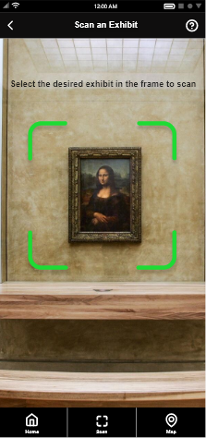
Heuristic Evaluation Findings
Error Prevention:
Improve our design in order to avoid
errors from occurring.
The tour ends abruptly when you click the button, without any
confirmation from the user.
Notes:
Conducting the heuristic evaluation brought all the problems with our prototype to light, we realized some of the oversights we had while designing our prototype. A major oversight we had was the lack of error messages to the user.
The severity ratings in the evaluation helped us categorize and prioritize the problems to solve. All the cosmetic problems and highly rated problems were solved.
We had a discussion about the various solutions we thought of for each problem to help us do this.
And n

Slide 8
Heuristic Evaluation Findings
Help users recognize, diagnose,
and recover from errors:
In case errors do occur, it is important to
let the user know and help them find a solution.
No information to let user
know about a failed scan.
Notes:
Conducting the heuristic evaluation brought all the problems with our prototype to light, we realized some of the oversights we had while designing our prototype. A major oversight we had was the lack of error messages to the user.
The severity ratings in the evaluation helped us categorize and prioritize the problems to solve. All the cosmetic problems and highly rated problems were solved.
We had a discussion about the various solutions we thought of for each problem to help us do this.
And n

Slide 9
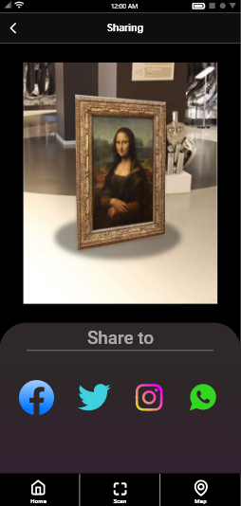
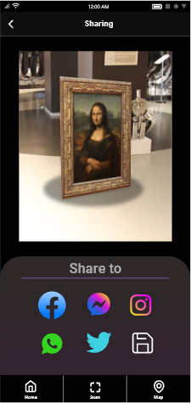
Heuristic Evaluation Changes
Improved user control and freedom

Slide 10
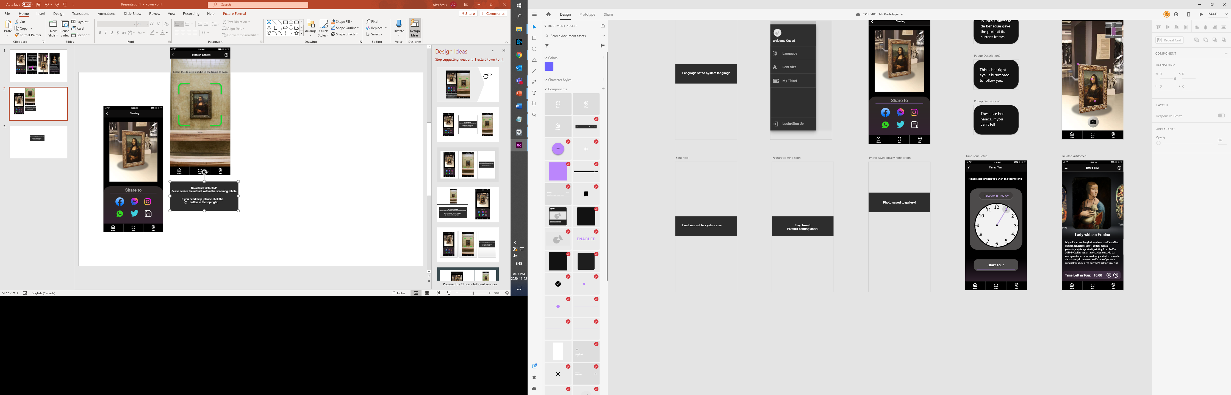
Heuristic Evaluation Changes
Improved visibility of system status

Slide 11
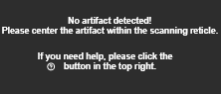
Heuristic Evaluation Changes
Help users recognize and recover from errors

Slide 12
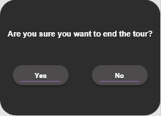
Heuristic Evaluation Changes
Improved user error prevention

Slide 13
Plans for Stage Five
Implement 2 additional tasks vertically
Ability for user comments on an Artifact.
Let user add display items to their Personal Gallery.
Add AR Animations.
Improve the UI and to give it a more modern look.
Incorporate feedback from our TA – Philmo Gu
Notes:
For the final stage of our project we plan to Implement 2 new additional tasks.
One of them being a comment section where users can comment on artifacts.
The second one being a Personal Gallery where users can add and view AR models from their Personal Gallery.
We also plan to add an AR animation feature where users can look at an animation of the selected artifact.
We also plan to improve the look of our UI and give it a more modern appearance.
And finally any feedback we receive from this stage from Philmo we will implement in the final stage.

Slide 14
Reflection
What went well
Problem solving
What went poorly
Finding issues
What would we do differently
Different evaluators

